Slide 1

Working With Data DATA9910
Week 2
Lucas Rizzo
email: lucas.rizzo@tudublin.ie

Slide 2
Indicative schedule
Week 1 | Set up environment and R notebook
Week 2 | Review Python and practice
Week 3 | Review R, importing data
Week 4 | Intro SQL and aggregate queries
Week 5 | Databases and scripting languages (To be submitted)
Week 6 | Interpreting Data (summary statistics, data visualisation)
Week 7 | Review week
Week 8 | Data manipulation in R Pandas and Numpy
Week 9 | Data visualisation in Python Data processing (regular expressions)
Week 10 | Audio data (R and tuneR) (To be submitted)
Week 11 | Image data (Python and skimage) (To be submitted)
Week 12 | Time series (Python and Pandas)
Week 13 | Working on Assignment Assignment deadline

Slide 3
Overview
Python
Data types
Functions
Lists
Sets
Dictionaries
Tuples
Strings

Slide 4
Before you start
You should be familiar with at least one general-purpose language
Functions / Methods
Flow-Control (if/else and loops)
Variables
Types
We are going to see a very quick introduction. More training is available on the datacamps provided.
Intro to Python for Data Science
Intermediate Python

Slide 5

Datacamp
You can access DataCamp courses for extra practice (that is highly recommended)
Please create an account with the @mytudublin.ie domain to have free access to all courses through the link below
Link to register on DataCamp
Some courses that might help you in the first weeks (not all there is covered in this module): Intro to Python for Data Science Intermediate Python
Introduction to R
Introduction to importing data to R
Web scraping in R

Slide 6
Python Built-in Data Types
Integer: Whole numbers (can’t contain decimals)
Float: Any number (can contain decimals)
Boolean: Either True or False
String: Text
List: A collection of values arranged one after the other
Set: A collection of values with no duplicates
Dictionary: A collection of values which can be accessed with lookups
Tuple: Similar to a list, but with a fixed size and order

Slide 7
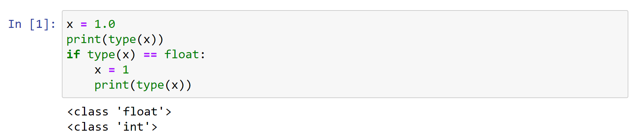
Checking and Converting Types
Usually you don’t need to worry about data types.
If you need to check you can use the type() function
This is called introspection, meaning that a variable might change its type, and you can check that during runtime.

Slide 8
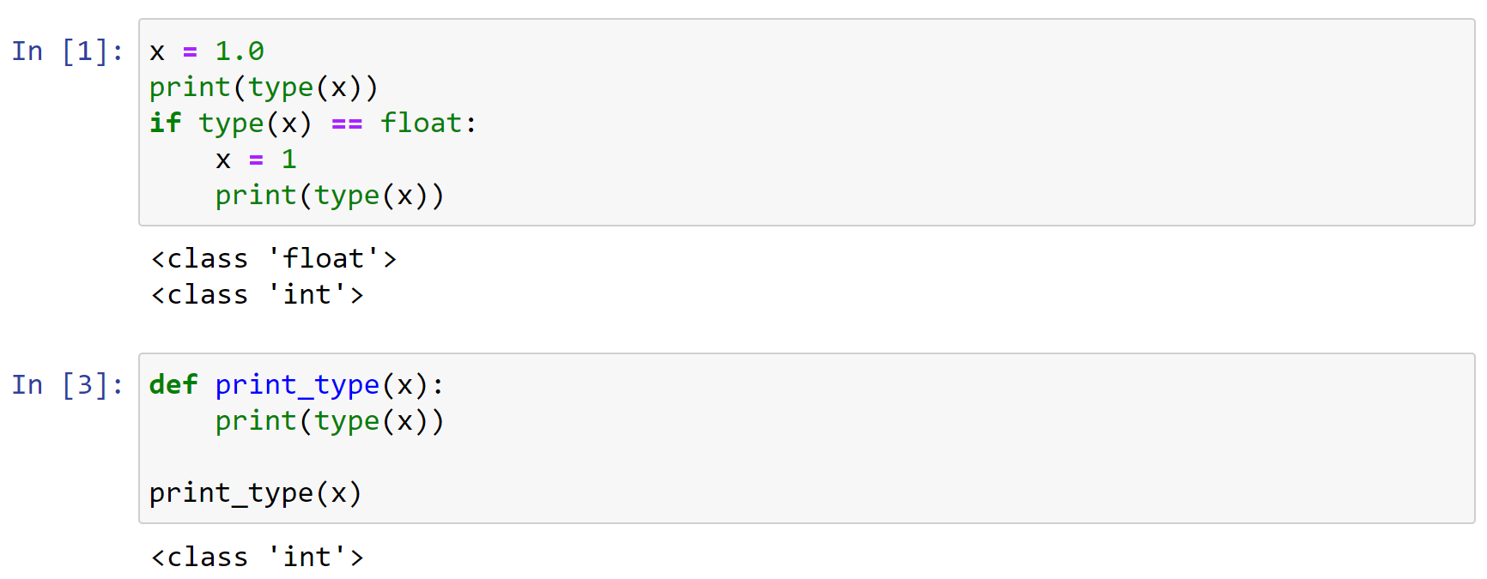
Python functions
A Python function is a block of code that returns something and that we can run later in the script
It allows us to reuse code
Functions can take zero or more parameters

Slide 9
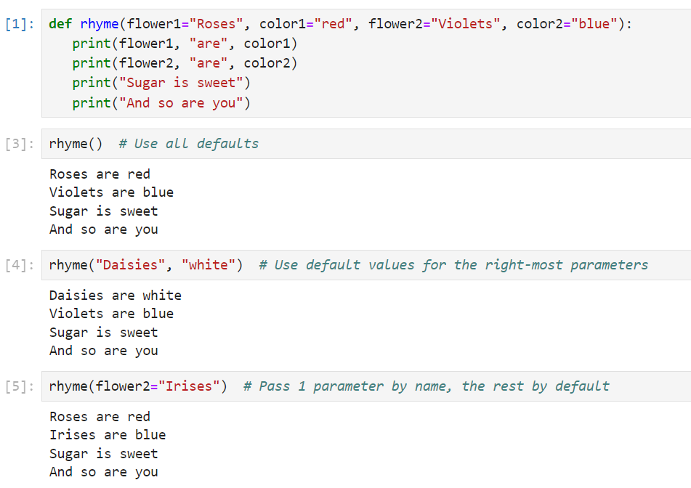
Python functions

Slide 10
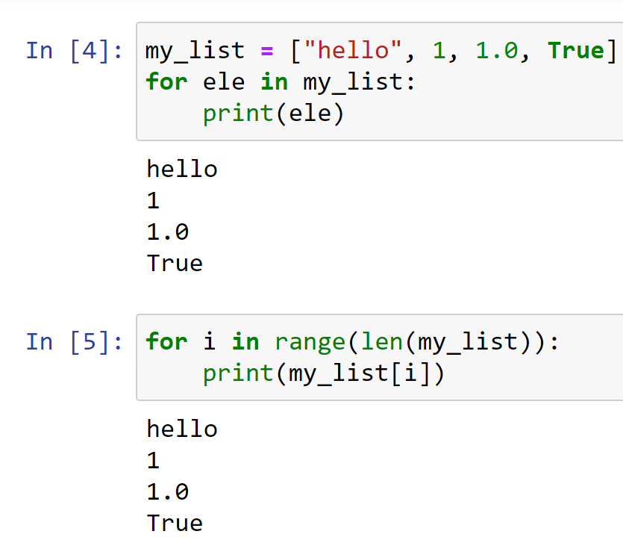
What is a Python List?
A list lets us pack lots of values into a single variable
Similar to an array in most other languages
We can use loops to process each item in an array
Or we can retrieve items individually by index
Python allows you to store different data types in a single list

Slide 11
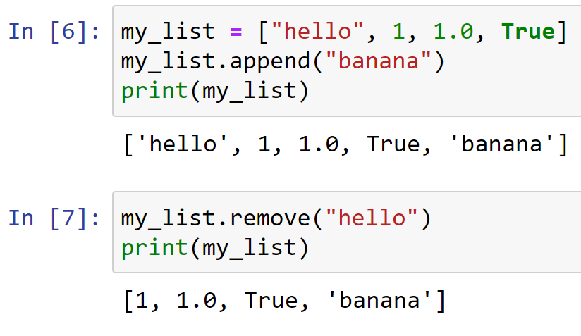
Working with Lists
We can create a list in Python using square-bracket notation
We can add items to the end of a list using the list append() method
We can remove items using the remove() method
This removes the first occurrence only
If the item doesn’t exist in the list we get an error

Slide 12
Accessing Items by Index
Each item in a list has an index, or position, within the list
Python indexes are zero-based
This means the first item has an index of 0
The second item has an index of 1
We can use the index to retrieve an item from a list

Slide 13
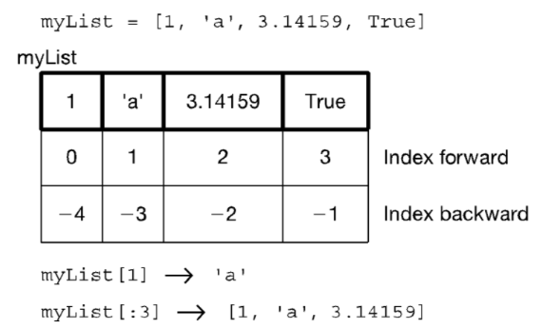
Accessing Items by Index

Slide 14
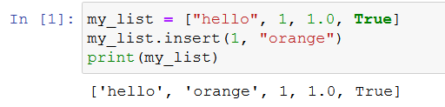
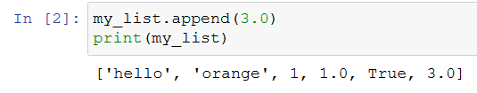
Inserting Items
We can insert an item in a specific position using the list insert() method.
Or add something in the last position using append()

Slide 15
List operators
Concatenate +
Repeat *
Indexing the [ ] operator
Slicing [start:end:step] (end not inclusive)
Membership (the in operator)
Length len (the length operator)

Slide 16
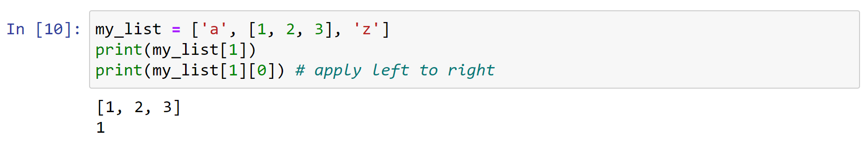
Lists of lists
What is the second element (index 1) of that list? Another list.

Slide 17
Some list methods
A list is mutable and can change
my_list[0] = 'a' #index assignment
my_list.append()
my_list.extend()
my_list.pop()
my_list.insert()
my_list.remove()
my_list.sort()
my_list.reverse()
Python documentation:
https://docs.python.org/3.1/tutorial/datastructures.html

Slide 18
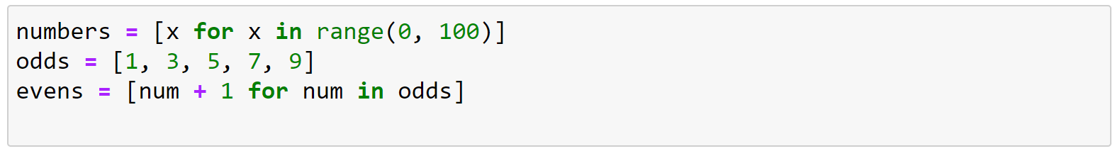
List comprehension
List comprehensions are a very readable way of creating lists (once you get used to them)

Slide 19
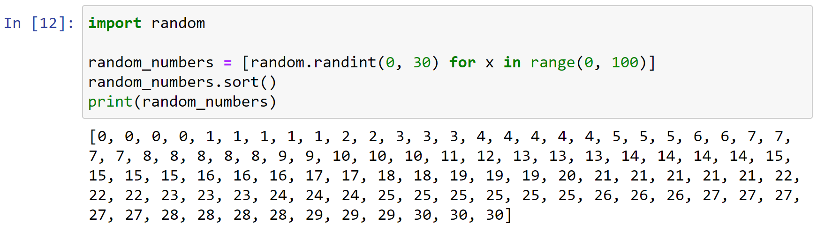
Sorting Lists
We can use the list sort() method to sort a list in ascending order

Slide 20
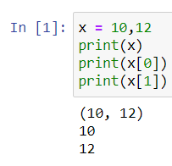
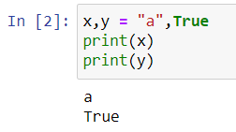
Tuples
Tuples are immutable sequences
They are printed with (,) and similarly to lists can have various length
Not a tuple, multiple assignment

Slide 21
Tuples
For the most part, tuples work exactly like lists
However, an immutable list gives you a data structure with some integrity, some permanent-ness if you will
You know you cannot accidentally change one.

Slide 22
Tuples
Everything that works with a list works with a tuple except methods that modify the tuple
Thus indexing, slicing, len, print all work as expected
However, none of the mutable methods work: append, extend, del

Slide 23
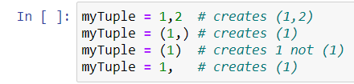
Tuples
For tuples you can think of a comma as the operator that makes a tuple, where the ( ) simply acts as a grouping:
That is an integer

Slide 24
Tuples
Suppose my_tuple = (1,2,3,4,5)
Concatenate: my_tuple + my_tuple
Repetition: my_tuple * 3
Index access: my_tuple[1]
Index access: my_tuple[-1]
Slice: my_tuple[:3]
Slice: my_tuple[1:3]
Membership: 2 in my_tuple
Membership: 10 in my_tuple
Length: len(my_tuple)
Minimum: min(my_tuple)
Maximum: max(my_tuple)
Sum: sum(my_tuple)
Comparison: (1,2,3) > (1,2,1)

Slide 25
Python Sets
A python set is similar to a list but
Sets can't contain any duplicates
Sets are unordered (no index)
Sets follow the rules for mathematical Set Theory
https://www.probabilitycourse.com/chapter1/1_2_0_review_set_theory.php
Checking if an item exists in a set is very fast

Slide 26
Creating a set
Sets can be created in one of two ways:
constructor: set(iterable) where the argument is iterable
my_set = set('abc')
print(my_set) 🡪 {'a', 'b', 'c'}
shortcut: {}, curly brackets where the elements have no colons
my_set = {'a', 'b','c'}
Duplicates are automatically removed
my_set = set("aabbccdd")
print(my_set) 🡪 {'a', 'c', 'b', 'd'}

Slide 27
Set Operations
len(s) → Number of elements in the set
x in s → test if set s contains value x
x not in s → the opposite of x in s
s.union(t) → new set with everything in s and everything in t
s.intersection(t) → new set containing elements in both s and t
s.difference(t) → new set with elements in s but not t
s.symmetric_difference(t) → new set with elements in s or t but not both

Slide 28
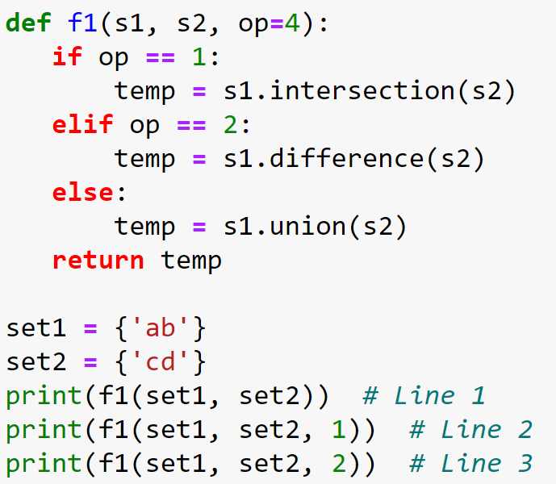
Check yourself
What is the output of (a) Line 1, (b) Line 2, and (c) Line 3
set(“ab”)
set(“cd”)

Slide 29
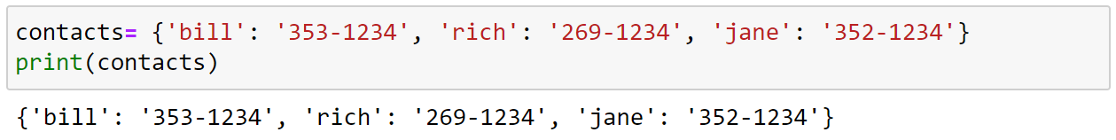
Python Dictionaries
In data structure terms, a dictionary is better termed an associative array, associative list or a map.
You can think if it as a list of pairs, where the first element of the pair, the key, is used to retrieve the second element, the value.
Thus we map a key to a value
Use the { } marker to create a dictionary. Use the : marker to indicate key:value pairs. Separate elements by comma.

Slide 30
Python Dictionaries
Key must be immutable
strings, integers, tuples are fine
lists are NOT
Value can be anything
Keys can not be repeated in the dictionary
Dictionaries are collections but they are not sequences (such as lists, strings or tuples)
There is no order to the elements of a dictionary
in fact, the order (for example, when printed) might change as elements are added or deleted

Slide 31
Dictionary operations
key in d: returns True if the item is found, False otherwise
d.get(key, [default value]): gets the item with the given key. If the key doesn't exist this will return default value, if you've given one, otherwise it will error
d[k] = v: adds v to the dictionary with the key k
d.keys(): returns the set of all keys in the dictionary d
d.values(): returns a list of all values in the dictionary d
d.items(): returns a list of all key-value pairs in the dictionary d
del d[k]: removes the item with key k from the dictionary

Slide 32
Looping through a Dictionary
We can loop through a dictionary just like we can loop through a list
The keys() method returns all of the keys in the dictionary
The values() method returns all of the values in the dictionary
The items() method returns both keys and values for the dictionary

Slide 33
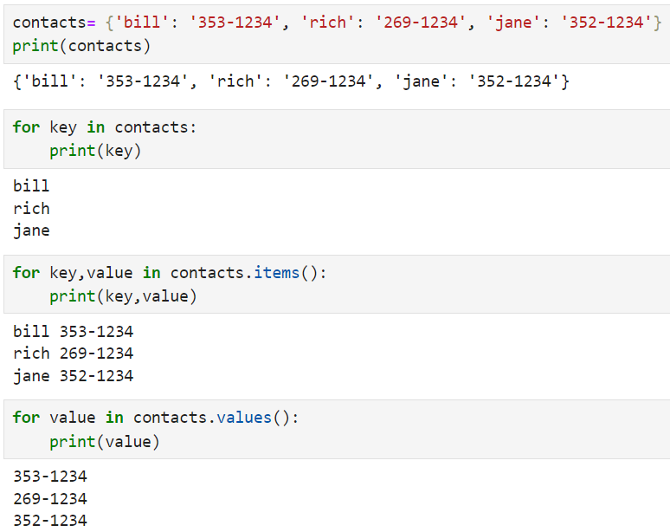
Looping through a Dictionary

Slide 34
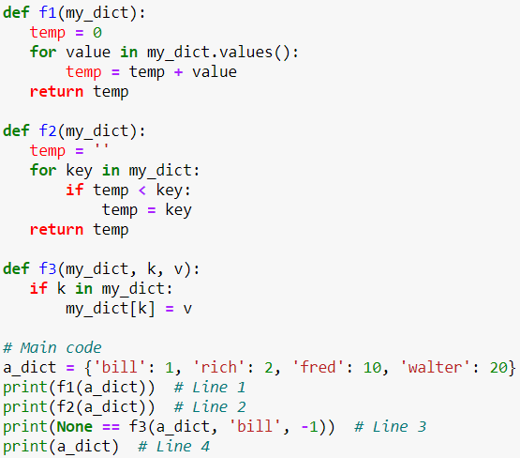
Check yourself
What is the output of (a) Line 1, (b) Line 2, (c) Line 3, and (d) Line 4?

Slide 35
Strings
A string is a sequence of characters
In Python it is enclosed between ' ' or '' ''
The exact sequence of characters is maintained
"Hello" or 'Hello' - OK
"Hello' - Error!

Slide 36
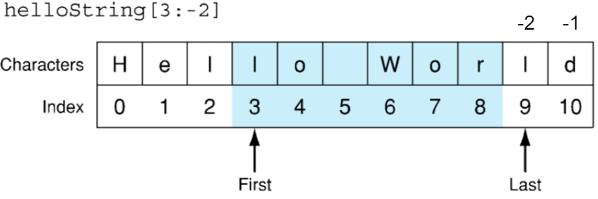
String Access
Essentially a string is a list of characters, so you can access a string by index
As with lists, slices and negative indexes work on strings

Slide 37
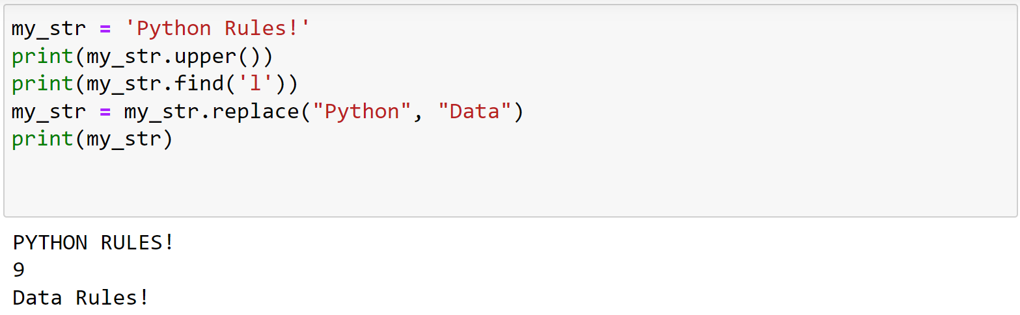
String methods
We can convert strings to lower and upper case using the upper() and lower() functions
We can search for text within a string using the string find() method
We can replace text within a string using the replace() method

Slide 38
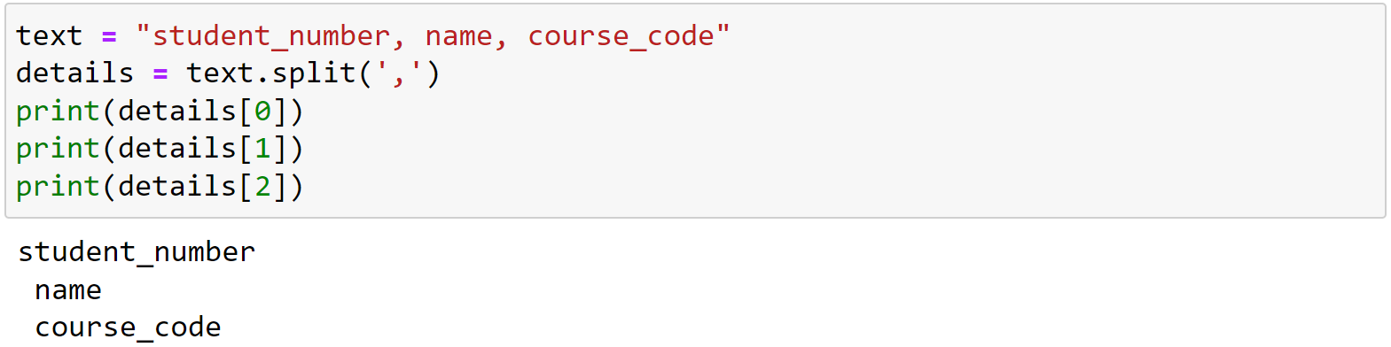
Split and join
The split() function converts a string to a list using a specified delimiter
The join() function converts a list to a string using a specified delimiter

Slide 39
Advanced String Manipulation
String manipulation is very important, particularly in Natural Language Processing
Regular Expressions (RegEx) is a mini-language used for advanced string matching and replacing
Text Preprocessing is very important in NLP and Python provides lots of libraries to help you do it.
All of this is for another day though!

Slide 40
Summary
Python
Data types description
Function syntax and how to create
Lists
How to create, access, loop through it, remove items, list operators, list methods
Sets
How to create and methods
Dictionaries
How to create, access keys and values, loop through it
Tuples
How to create, operators and methods
Strings
How to create, access and use some of its methods
Next week: R data structures and data importation

Slide 41
Questions?

Slide 42
Lab
Python practice exercises in Jupyter Notebook

